Slide 1
Module Five
JOB DESIGN

Slide 2
Job Design
Job Design: the specification of task activities associated with a particular job.
i.e. it is the linking of specific task behaviours to jobs.

Slide 3
Scientific Management
Job Design
is breaking down work into elements which are analyzed by number and the time necessary to complete them and recombines the core elements to create the most efficient job design.
This approach to the work design tried to ensure the maximum productivity of labour so that the corporation could achieve maximum economic efficiency.
Scientific management has led to the development of the modern day production methods.

Slide 4
Implications of Scientific Management
The effects of scientific mgt. on employees are:
- Limited social interaction
- Low skill requirementst specialised to keep training costs low.
- Job activity repetition
- Task specialization
- Low employee creativity and ingenuity .

Slide 5
Scientific Management Decline
Scientific management is no longer viewed as a universally applicable method for rationalising all production systems, but still has its advocates and benefits.
Job satisfaction declined under the restrictive work systems created by the application of scientific management, managers observed declines in job involvement, company loyalty, product and service quality and productivity.
Its implementation has created work adjustment problems for employees, higher turnover, absenteeism and lowered production quality.

Slide 6
QUALITY OF WORK LIFE
“QWL”
It refers to the extent to which employees are able to satisfy personal needs through their work .
QWL programs also focus on improving the performance of employees.
QWL programs integrate employee needs with organizational goals.

Slide 7
QUALITY OF WORK LIFE
“QWL”
Recently, QWL effects become mainly judged in terms of organizational payoff such as:
  Improving a competitive edge like product innovation
  Lowered warranty claims
  Improved customer service

Slide 8
QUALITY OF WORK LIFE
“QWL”
Conclusion:
QWL programmes are valuable, but they must show a noticeable, positive effect on the bottom line ( not to be just limited to increasing job satisfaction) as well as meeting the higher order needs of employees!
The features of QWL show up in company programmes such as use of self-managed teams, employee empowerment and Scanlon-like plans.

Slide 9
Horizontal increases in Job Design
Job rotation: The practice of periodically shifting workers through a set of jobs in a planned sequence.
Cross training: is a variation of job enlargement because employees are trained in different specialized work activities.

Slide 10
Cross-Training
Cross-training practices called skill-based learning, where employees can earn bonuses and rises when they acquire new work skills, can make employees more versatile.
Such programmes increase the expertise of the workforce but they also create pressures on the pay system.

Slide 11
Job Enlargement( Horizontal)
The allocation of a wider variety of similar tasks to a job in order to make it more challenging.
It increases the number of work activities in a job to decrease the extent of boredom and over-specialization experienced by the employee.
Job enlargement may be a more effective job design principle because it changes the nature of work by trying to eliminate the over specialization created by scientific management.

Slide 12
What is Job Enrichment
(Herzberg’s Theory)
Job enrichment: The process of upgrading the job-task mix in order to increase the potential for growth i.e promotion ( to include motivational factors).
Challenge, responsibility, recognition and pride also considered as motivational factors
It frequently requires employees to acquire new skills as tasks are added to expand the basic nature of jobs.
Employees must be willing to accept more responsibility.

Slide 13

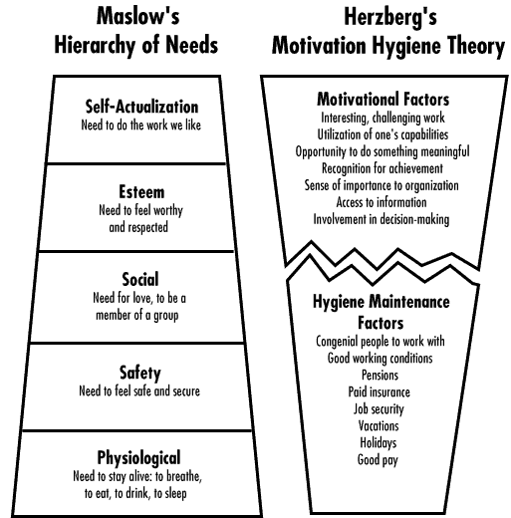

Slide 14
Job Design and Herzberg’s
Two-Factor Theory
Theory of Job motivation ( Job enrichment):
Job enrichment proposes that jobs should include motivating factors.
Herzberg found that employees are motivated by work when the motivating factors of challenge, responsibility, pride in work, recognition and opportunities for personal growth (promotion) are abundant and attainable.

Slide 15
2-Factor Theory
Hygienes (extrinsic factors ) are those conditions which must exist in the context of work to maintain a condition of ‘no dissatisfaction’.
They include: salary, job security, working conditions, company procedures, quality of supervision and the quality of relations with superiors, peers & subordinates.

Slide 16
Motivators such as challenge, responsibility, pride in work, recognition and opportunities for personal growth (i.e., promotions ) produce job satisfaction.
The motivators are labeled as intrinsic factors or satisfiers.
.

Slide 17
Principles of Herzberg
Job Design
Principles:
1 - Give employees as much control over the mechanisms of task completion as possible.
Example: A manager allows repairmen to order parts and maintain inventories.
2 - Hold employees accountable for their performance.
Example : A manager conducts semi-annual, formal feedback sessions with subordinates concerning goal achievements

Slide 18
Principles of Herzberg for Job Design
3 - Within limits, let employees set their own work pace.
The company installs a flexible hours work policy.
4 - Design jobs so employees experience accomplishment.
A manager gives employees the authority to handle customer complaints personally.
5 - Design jobs so employees learn new skills and work procedures.
A company offers a seminar to teach managers approaches to quality control.

Slide 19
Job Depth and Job Range
Job Range : refers to the number of tasks an employee performs(horizontal)
Job Depth : is the amount discretion which a person has to select various jobs procedures to accomplish work.( vertical)

Slide 20
Job Depth and Job Range
HIGH
Machine maintenance man
Department head
Hospital nurse
Chemical plant supervisor
Chief of surgery
Chief executive officer
Prime minister
Director of a research laboratory
JOB RANGE
Assembly-line worker
Medical record clerk
Rubbish collector.
Professor
Judge
Computer technician
Civil engineer
LOW
LOW
Job Depth
HIGH

Slide 21
What is Job Depth
Job depth: the degree to which individuals can plan and control the work involved in their jobs.
or is the amount of discretion the employee has to select various job procedures to accomplish work.
Vertical loading methods for increasing job depth:
  Employees should be provided with direct feedback on their performance

Slide 22
Criticism of Herzberg
Herzberg believed that only certain jobs should be enriched and that workers
Too simple theory.
Humans tend to blame external factors when they experience dissatisfaction while give themselves credit when they experience satisfaction.
He believed that management should make all decisions about job enrichment without the participation of employees who will have the jobs .

Slide 23
THE JOB CHARACTERISTICS MODEL
JOB
CONTENT
FACTORS
CRITICAL
PSYCHOLOGICAL
STATES
PERSONAL
AND WORK
OUTCOMES
Motivators
Skill variety
Task identity significance
Task significance
Social significance
Experiencing meaningful of work.
High internal work motivation
High quality performance
High job satisfaction
Low absenteeism and turnover
Autonomy
Experienced responsibility for work outcomes
Feedback( job depth)
Knowledge of results of work activities

Slide 24
Growth Need Strength
This individual quality refers to a cluster of higher order needs including:
1) Achievement
2) Interest in work.
3) independence
4) Personal control over work.
5) Challenge
It influences the basic relationships in the model and must be considered ahead of any job design.

Slide 25
The importance of individual differences in job design
An employee with high growth need strength is highly motivated by challenging work and who prefers to make decisions which lead to advancement.
Employees with low growth need strength do not prefer jobs with extensive job content factors.
Job design is effective with workers having high growth need strength working at jobs with few job content factors.

Slide 26
Job Content Factors
Skill Variety: The extent to which the job requires a number of different skills, talents and abilities to accomplish task activities.
Jobs which require both technical and interpersonal skills posses high skill variety (e.g. lawyers and social workers.)
2. Task Identity: the degree to which the job requires doing a complete task from beginning to end and experiencing a visible and identifiable outcome (surgeon).

Slide 27
Job Content Factors
Task Significance : The degree to which the job has a substantial and lasting influence on the lives of employees and other people , both on the immediate organization and in society
Autonomy: The degree to which the job gives the employee personal freedom and discretion to control work activities and schedule (judge/ professor)

Slide 28
Job Content Factors
Feedback from the work itself: direct and complete information on the effectiveness of employee work behaviour.
Social Opportunities: The extent to which the job allows the employee to have social contact with friends and requires interaction with others to complete the work.

Slide 29
Job Design Principles
Vertical Job-Loading
Vertical job-loading refers to those changes which influence the planning and doing components of work.
When an employee experiences more control, autonomy, challenge and direct responsibility over work outcomes, then the job has been vertically loaded or expanded.
Could be called increasing job depth.

Slide 30
Job Design Principles
Vertical Job-Loading
1 - Employees should receive feedback on their performance.
Jobs should be designed to make employees own quality control inspectors.
Formal and informal performance reviews should be scheduled & be frequent.
2 - Employees should have opportunities to learn new skills.
The employees need to expand aptitudes and competencies.
3 - Employees can influence the scheduling of work.
An example is a flextime programme that is based on individual needs, vary work arrival and departure times as long as the employee works the required hours/ week.

Slide 31
Job Design Principles
4 - Each job should be given some unique qualities .
(The job should fit the personality of its holder).
5 - Employees should have control over job resources.
6 - Personal accountability should be increased.
This means employees should be held accountable for the outcomes they achieve at work.
All of these changes can improve motivation, job satisfaction and performance of employees.
They require managers to better delegate authority & be willing to assign quality control activities to employees.

Slide 32
Other Approaches to Job Design
1- Four-day work /week:
Organizations allow employees to work four 10-hour days to create three-day weekend.
(higher accident rates, employee fatigue, a second job)
2- Job-Sharing: two employees fill one job.
The concept allows mothers to work as they raise their families. Job sharing often results in less fatigue, less boring work, higher productivity, lower fringe benefits costs.

Slide 33
Other Approaches to Job Design
3- Telecommuting:
work is performed with computers by employees in their homes. In USA over 2 million people currently perform their jobs in this fashion.
Telecommuting is a joint effort of employee and the organization to create a better fit personal needs and organizational demands.

Slide 34
Other Approaches to Job Design
4- Flextime:
Employees determine when they arrive at work and when they leave.
Employees must work a specific number of hours each week.
Flextime may lead to lower absenteeism, increased productivity, reduce overtime expenses, higher job satisfaction and fewer episodes of traffic congestion at work facility.
Flextime may not appropriate for service organization with extensive customer interaction.

Slide 35
Assessing Managers’ Interests in Job Design
1- Work design alters the relationship between people and their jobs.
2- Job design directly changes behaviour since it focuses on what employees do instead of what they feel (emotions). This sort of change is more durable.
3- Job design offers opportunities for initiating other changes. A successful job design effort encourages more flexible employee attitudes and employees can become more innovative in their work.
4 - Job design helps organisations better satisfy employee needs.

Slide 36
Problems in Job Design Programmes
1- Technology.
The economic savings of assembly line job designs may be so great that the organisation can be profitable even with employee job dissatisfaction and high turnover.
2- Programme start up and maintenance costs.
The full costs of sustaining a job design programme can force an organisation not to initiate or to end its job design programme.
3- The failure to consider employee preferences.
A job design programme can fail because it does not account for the needs of employees. Programmes designed and implemented by management without significant employee input fail due to low employee commitment.

Slide 37
Problems in Job Design Programmes
4- Managerial and union resistance.
Managers must delegate authority in a number of ways to make a job design programme work.
Some will resist job changes which focus on altering the job depth of their subordinates.
Job insecurity caused by downsizing and restructuring of production assets has made it easier for managements to shift product to subsidiaries that have little labour unrest from those undergoing labour turmoil.

Slide 38
The Team Approach
to Job Design
Socio-Technical System Theory
The socio-technical systems theory is composed of two interdependent elements:
The social element represents the social and interpersonal aspects of task group behaviour to get their work done.
The technical element refers to the operational, equipment and technical/mechanical processes used by task groups .
Self-managed team , Self-directed team
Cross-functional team

Slide 39
Socio-Technical System Theory
Socio-technical systems theory integrates two opposing forces in the design of work:
The scientific management and productivity emphasis on specialisation
2) The human needs and interpersonal relations aspects of the behavioural sciences .

Slide 40
Self-Directed Teams
Self-directed teams are autonomous work groups which integrate the technical and social aspects .
They are made up of members who are jointly responsible for ensuring that the team accomplishes its goals and who lead themselves
It is a type of job design which provides a competitive edge based on improvements in the design of work.

Slide 41
Self-Directed Teams
The basic building block is the autonomous work group which has the following qualities:
1 - The group is assigned a whole task with a clear and significant mission .
2 - Each worker possesses a number of skills required for completion of the group task. When individuals do not have solid skills , cross training among members is encouraged.

Slide 42
Self-Directed Teams
3 - The group is given autonomy to make decisions about the work methods ,the scheduling of activities, the assignment of individuals to tasks and the selection of new group members.
4 - Compensation is based on the performance of the group as a whole rather than on the contributions of individual group members.

Slide 43
Self-Directed Teams
Autonomous work groups may have rotating leadership positions
Since rewards, bonuses and pay rises are contingent on group performance, members value interdependence and collaboration in their work.
They learn that these are the behaviours which make the group more successful in meeting its product quantity and quality challenges.

Slide 44
How Managers Design
Self Directed Teams
The companies interested in setting up self-directed teams must consider the following:
1) Creation of high performance norms.
2) Minimising group conflict to useful ends.
3) Creating satisfying interpersonal relations .
4) Integrating characteristics of the technical work system into the structure of the group.

Slide 45
Hackman’s Outlines for
Designing Self-Directed Teams
The team number should be small (8–20 Members).
Training should be cross-training.
The individual pay is determined by team performance.
The role of the supervisor should be changed from vertical liaison with higher management to horizontal integrator of other work teams.
The team should be given the authority to plan, organise & control a defined work & be responsible for both the quality & the quantity of its performance.
This is an expanding job range and job depth for the
team.

Slide 46
Self-Managed Teams
The self-managed teams are based on socio-technical systems theory.
The self-managed teams are formal work groups made up of members who are jointly responsible for ensuring that the team accomplishes the goals and who lead themselves.

Slide 47
Self-Managed Teams
1- Evaluate each other’s performance, using peer appraisals.
2 – Cross-train each other until all members are familiar and competent to perform all related jobs assigned to the team.
3- Schedule work and assignments within the team, which could be based on flextime or four day 40 hours work arrangements.
4 - Divide work assignments to fit the needs of team members.
5 - Monitor team performance, make corrective changes in work processes and equipment utilisation and report the results of these activities to higher management.
6 - Apply TQM principles and service quality improvement activities to al phases of the team’s work.

Slide 48
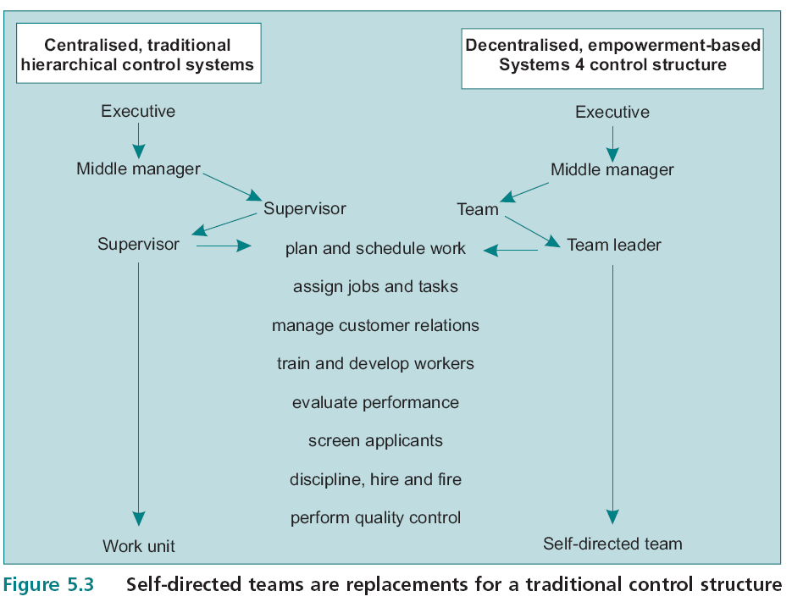

Slide 49
The NUMMI System
New United Motor Manufacturing
1- Employees are carefully selected after assessment process which includes individual and team interviews, exams and problem simulations.
2- An orientation programme for new employees includes team concepts as well as principles of cross training.
3 -New employees sign a contract includes job security.
4 -Examples of status such as management on were removed.
5 -Top management advanced the principles of trust and respect .
6- A suggestion system with a rapid feedback was installed.

Slide 50
The NUMMI Application System for Self Managed Teams
7- Jobs were integrated to eliminate excessive job specialisation .
8- Recognition and incentives for suggestions were team based .
9- Wage compression in self managed teams allowed team leaders to earn only $0.40 more per hour than team members.
10 -Plant management shared with self managed teams information about performance, quality and plant safety.

Slide 51
EMPOWERMENT
Empowerment is the sharing of decision-making power by the organization with its employees.
It is commonly found in organizations that support participation and exhibit features of system 4 organizations.

Slide 52
Lean Production Systems
“Re-engineering”
Elimination of buffers or inventory, including extra workers
Quality and efficiency are seen as positively related
Emphasis on ability to change quickly from one product to another
Multi-skilled workers with a good understanding of the production process.
Higher level of training

Slide 53
Lean Production Systems
“Re-engineering”
Commitment to retain highly trained workers
Compensation that is partly contingent on corporate, plant and/or individual performance.
Reduction of status barriers
High-commitment work practices

Slide 54
Participation important features
Participation is composed of three elements:
1) Psychological and physical job involvement.
2) Motivation to contribute.
3) Acceptance of Authority & responsibility.
Organisations can increase their competitive advantage by adjusting their workforce practices based on the principles of participation, empowerment and self directed teams.

Slide 55
System 4 Organizations
A System 1 organisation: is one that ignores the importance of teamwork in organisational effectiveness.
System 4 Organizations use participation and empowerment in job designs to raise individual and work team effectiveness.
Managers who wish to use participation more effectively must give employees the opportunity to become accustomed to the behaviours required by participation.
System 4 Organizations

Slide 56
Contrasting the participative and
non-participative organization
System 1
System 4
Leadership does not value or instill confidence and trust.
Centralized control
Motivation systems which operate on lower-order needs.
Communication only flows downward
Subordinates are not involved in goal setting
Top level decision making
Low performance standards
Leadership instill confidence and trust .
Self-control
Motivational systems which tap the full hierarchy of needs .
Communication flows in all directions
Subordinates involved in goal setting
All levels decision making
High performance standards.

Slide 57
Considerations for Managers who Wish to Use Participation and Empowerment Effectively
Managers must be willing to meet certain organisational and personal prerequisites before they try to ‘democratise’ their organisation.
Employees must be trained to be effective members of empowered, self-directed teams. empowerment and self-directed teams cannot be installed under emergency or crisis conditions.
Manager must believe in, and practise the principles evident in the System 4 organisation. He moves from being a source for decisions to being a coach for self-directed teams and an integrator of self-directed team activities.
Managers must firmly believe that employees have or that they can develop a high growth need strength.

Slide 58
Considerations for Managers who Wish to Use Participation and Empowerment Effectively
Employees must view participation as a central feature of their orientation to work and professional development.
Employees must have the ability to attack problems which are best solved through participative means. Employees should receive training .
Employees must use common organisational terminology when they are given the task of solving problems participatively.
Managers and employees must accept the fact that programmes of empowerment, self-directed teams and introduction of new technologies are all facets of creating and sustaining competitive advantage.
The failure of organisations to renew themselves through these processes can lead to declining profitability .

Slide 59
Scanlon Plan
It is a form of managed participation which focuses employees’ attention on receiving group-based rewards for achieving productivity gains.
The plan is a system which sets up a series of employee committees for:
  1) Reviewing work procedures.
  2) Evaluating suggestions for improving productivity and cutting costs
  3) Involving employees in production decision making
System 4 Organizations

Slide 60
Scanlon Plan
A Scanlon Plan allocates group-based bonuses to employees who are able to exceed a historical standard for product output, total labour hours, materials usage
Benefits of Scanlon Plans include greater employee participation, wider acceptance of changes in work procedures, increased output and efficiency and better worker-management relations.

Slide 61
Limits to Participation in Organisations
1- The industry in which the firm is located has high entry barriers and its customers are very loyal to the industry’s firms and their products.
2- Global competitors tend to overlook the industry because it is too small, or the firms in it have excellent product and process protection through trade marks, patents and licences.
3- Worker productivity gains can still be achieved without greatly increasing capital intensity.
4- The organisation already has lean staffing systems. This means that the organisation has few management layers.

Slide 62
Limits to Participation in Organisations
5 -Employees’ jobs are specialised and their work is controlled by standard rules and regulations.
6 -Organisations may not have employees of sufficient ability to solve problems through participation.
7- Only employees with high growth need strength can be expected to respond positively to increased job depth (empowerment and participation).
8- Heavily unionised organisations may find it very difficult to redesign jobs in such a way that self-directed teams, empowerment and participation are successful.

Slide 63
Limits to Participation in Organisations
9- Installation of participation and empowerment is often accompanied by layoffs of lower and middle managers. While the layoffs may reduce costs ,they may also deplete the organisation’s managerial resources.
10 - Organisations may start participation and empowerment only to lose their way because the process of change becomes an end in itself rather than means to improve performance, productivity and quality.

